Slide 1

Inborden Elementary STEAM Academy
Kindergarten
Syllabus

Slide 2

Teachers
Kristina Caburnay
Email: caburnayk@in.halifax.k12.nc.us
Cell No.: (252) 532-5288
Office Hours: 3:30 - 4:00 PM
Rashonda Odom
Email: odomr@in.halifax.k12.nc.us
Cell No.: (252) 450-5182
Office Hours: 3:30 - 4:00 PM
Wilma Bryant
Email: bryantw@in.halifax.k12.nc.us
Cell No.: (252) 567-2119
Office Hours: 3:30 - 4:00 PM

Slide 3

Welcome to Kindergarten! We are so excited to have your child in class this year. We look forward to getting to know your child and helping him/her grow academically and socially throughout Kindergarten. We are confident that we will have a great year and work together to provide your child with the best education possible.

Slide 4


Supply List:
● pocket folder (for communication between home and school) (2)
● one pair black socks (used to erase student white boards) ● scissors
● highlighters
● pencils
● headphones/ear buds
● tissues
● hand sanitizer
● Clorox/Lysol wipes ● 1 subject notebook (2)
● Hand writing paper
● crayons/colored pencils
● glue sticks
● 1 pack of loose leaf paper

Slide 5

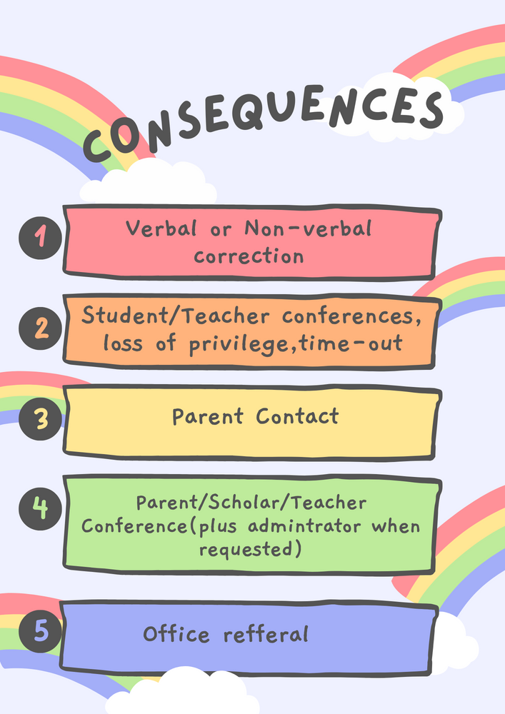
Classroom Rules and Consequences

Slide 6
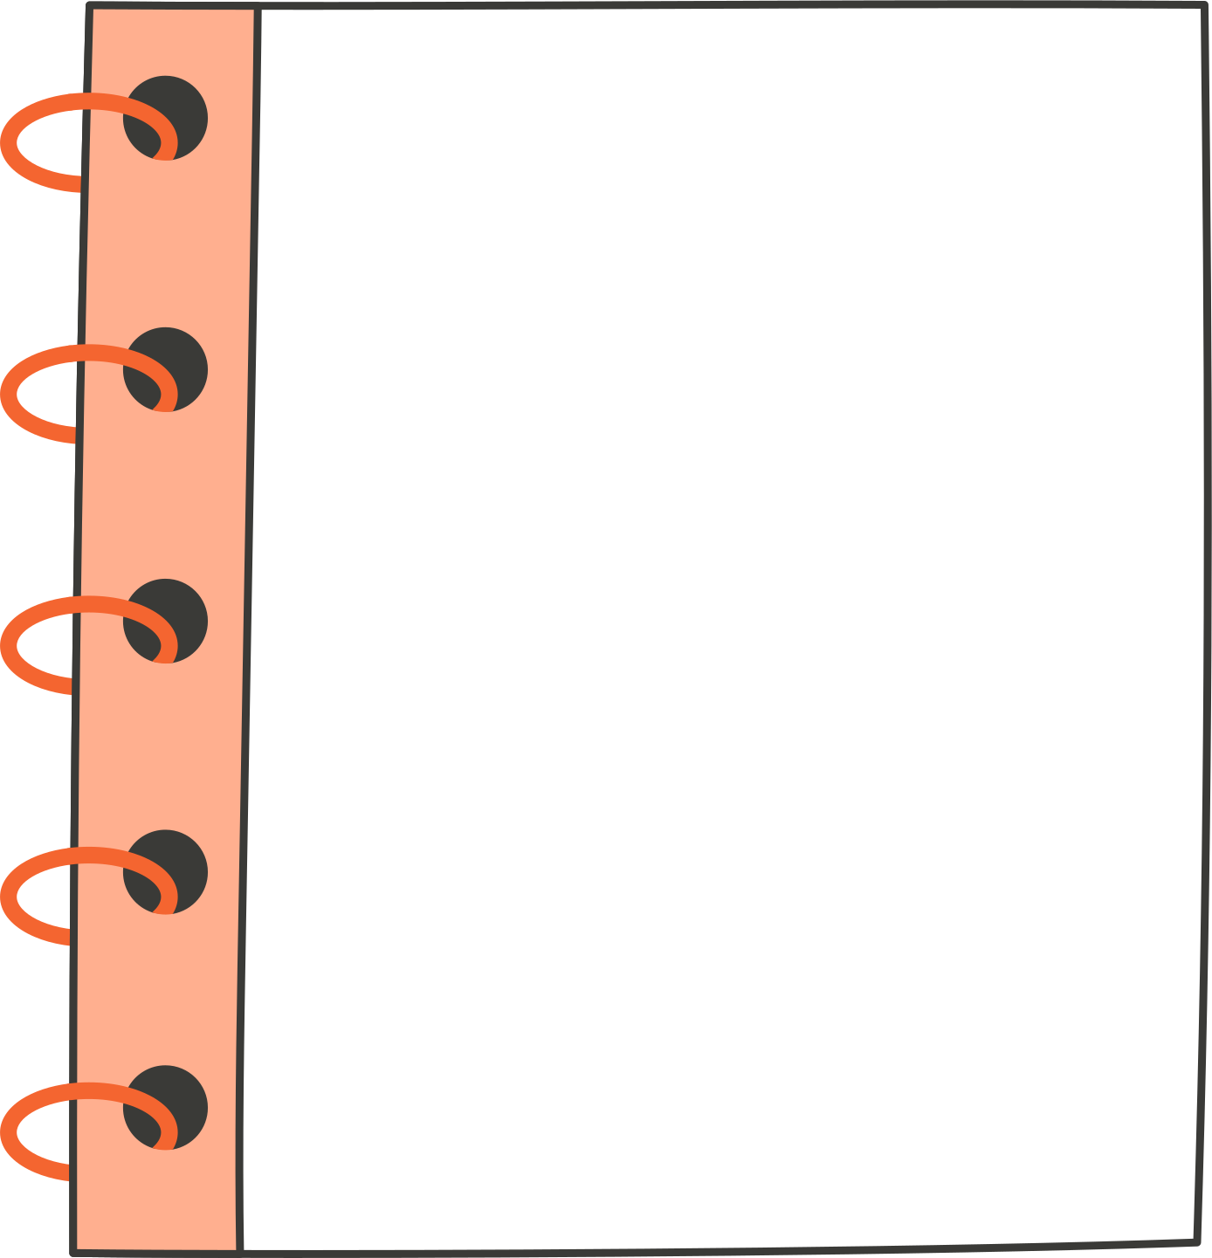
Grading Scale
Satisfactory (S) - 100-75
Needs Improvement (N) - 74 -65
Unsatisfactory (U) - 64 and below

Slide 7
Assignment/Homework Policy
All assignments in class and sent home should be completed to the best of the student’s ability. The teacher is here to help students become academically successful, meaning we need to know what the student knows and doesn’t know. Therefore, the students should attempt to complete assignments independently. The students are also expected to read and practice math skills nightly, even when an assignment has not been given.

Slide 8
What will students learn this year?

Slide 9
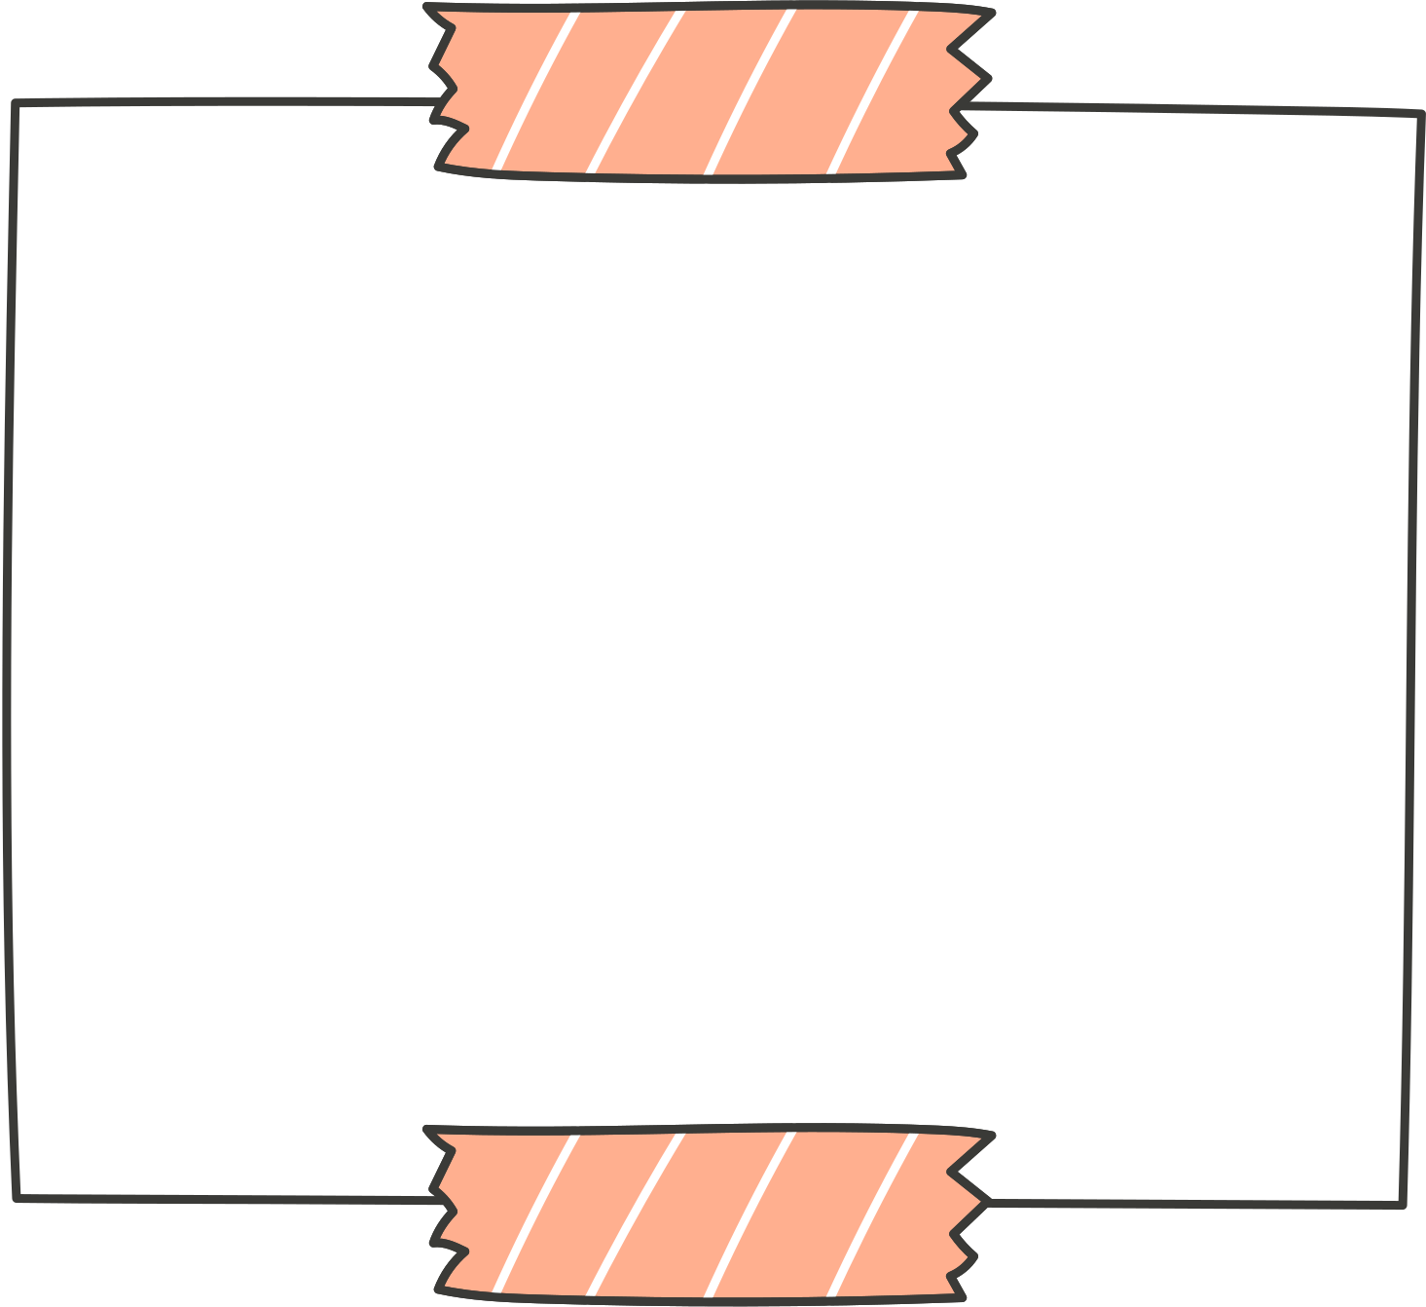

English Language Arts
●Ask and answer questions about key details in a story and demonstrate understanding of their central message or lesson.
● Distinguish long from short vowel sounds in spoken singlesyllable words
● Describe characters, settings, and major events in a story, using key details.
● Decode regularly spelled one-syllable words.
● identify main idea
● identify who is the narrator
● use end punctuation for sentences
● determine the meaning of unknown words and phrases
● Identify words and phrases in stories or poems that suggest feelings or appeal to the senses.

Slide 10
Math
● Count to 100, starting at any number less than 100
● Read and write numbers, and represent a number of objects with a numeral, to 100
● Compare two-digit numbers based on the value of the tens and ones digits, recording the results of comparisons with the symbols with the symbols <,>, and =
● Use concrete models and drawings, strategies based on place value, properties of operations, and explaining the reasoning used, add, within 100, in the following situations: a two-digit number and a one-digit number
● A two-digit number and a multiple of 10

Slide 11
Science
● Understand change and observable patterns of weather that occur from day to day and throughout the year.
●Compare the relative position of various objects observed in the classroom and outside using position words such as: in front of, behind, between, on top of, under, above, below and beside.
●Infer that change is something that happens to many things in the environment based on observations made using one or more of their senses.
● Give examples of different ways objects and organisms move (to include falling to the ground when dropped) Straight , Zigzag, Round and round , Fast and slow, Back and forth
●Summarize daily weather conditions noting changes that occur from day to day and throughout the year.
●Compare weather patterns that occur from season to season.
●Property of Matter Structures and Functions of Living Organisms Understand how objects are described based on their physical properties and how they are used.
●Compare characteristics of animals that make them alike and different from other animals and nonliving things.
●Classify objects by observable physical properties (including size, color, shape, texture, weight and flexibility).
●Compare different types of the same animal (i.e. different types of dogs, different types of cats, etc.) to determine individual differences within a particular type of animal.
●Compare the observable physical properties of different kinds of materials (clay, wood, cloth, paper, etc) from which objects are made and how they are used.
●Compare characteristics of living and nonliving things in terms of their: Structure - Growth - Movement - Basic needs - Changes

Slide 12
Social Studies
● Identify inquiry as a process to answer questions and solve issues.
●Recognize a compelling question with prompting and support.
●Explain why or how a compelling question is important to a topic or issue.
● Identify what questions are needed to support the compelling question.
●Recognize how supporting questions connect to compelling questions.
●Demonstrate an understanding of facts, opinions, and other details in sources.
●Identify the information surrounding a primary or secondary source including who created it, when they created it, where they created it, and why they created it.
●Construct responses to compelling questions using information from sources.
●Identify problems related to the compelling question that students think are important.

